Slide 1

REVIEW RATING PREDICTION

Slide 2
SUBMITTED BY Steffin Varghese

Slide 3
INTRODUCTION
E-Commerce platforms are having a good time during the past few years as the customers are opting for digital shopping. With the impact of digitalization and pandemic in the past few years, the demand for online shopping have been always going up. As the demand is steadily increasing, a greater number of e-commerce sellers are adding up to the market to catch up with the trend. So, the competition for capturing the market is high and e-commerce sellers are finding different ways to satisfy the existing customers and expanding their reach by influencing the potential customers in online shopping.
While looking for the new customers, E-Commerce sellers always have to give much importance to one thing. The way they treat their existing customers. Because, now a days, almost all sellers are providing good quality products at best price, but they are lacking behind when it comes to customer support. Considering this crucial factor, e-commerce sellers implemented the customer rating and feedback program, where the customers can rate and provide their reviews and feedbacks on the quality of product, price, and services during and after the sale from the seller. This will help a new customer to gather information on the product as well as the customer satisfaction on the seller during and after purchasing the product.

Slide 4
Understanding the Problem
We have a client who has a website where people write different reviews for technical products. Now they are adding a new feature to their website i.e. The reviewer will have to add stars(rating)as well with the review. The rating is out 5 stars, and it only has 5 options available 1 star, 2 stars,3 stars, 4 stars, 5 stars. Now they want to predict ratings for the reviews which were written in the past and they don’t have a rating. So, we have to build an application which can predict the rating by seeing the review.

Slide 5
Steps in Exploratory Data Analysis
Loading the dataset
Characteristics of Dataset
Exploring Categorical Variables
Checking for Missing Values
Data Cleaning
Checking the Presence of Outliers
Data Visualization
Balancing Data
Text Vectorization

Slide 6
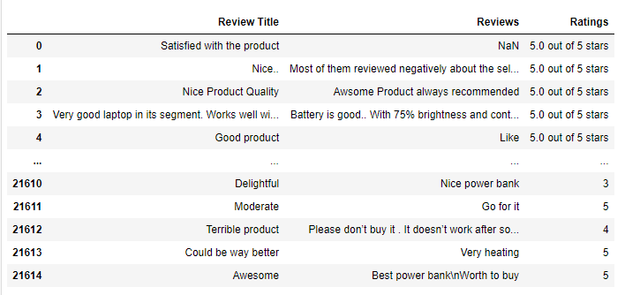
Data Sources and their formats
We had to scrape 20,000 records of customer reviews from two websites: - Amazon.in, Flipkart.com
We have collected customer reviews for the products:
Laptops Phones Headphones
Smart Watches Professional Cameras
Printers Monitors Home theater
Router Power bank
We have collected 21615 records of customer reviews and ratings. We have two features and one target column in the dataset.
Dataset

Slide 7
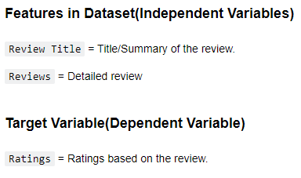
Data Variable Description

Slide 8
Data Preprocessing
Text Processing
While exploring the categorical variables, there are many words, numbers, as well as punctuations which are not important for our predictions. So, we had to process the text.
Using the user defined function “clean_text”, we removed numbers, URLs, punctuations, and other unwanted characters from the data and unshrink the words which were mentioned in short forms.
Removed StopWords
Lemmatization – Using wordnet lemmatizer and word tokenize, we removed the inflected forms of words and converted them to their ‘lemma’ or dictionary form.
Text Normalization – Standardization – We used user defined function ‘scrub_words’ to remove html tags, non-ascii and digits and white spaces from the text data.

Slide 9
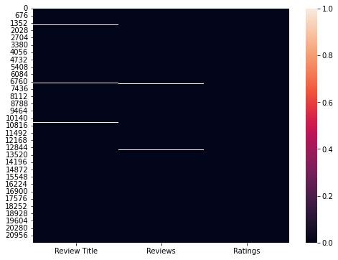
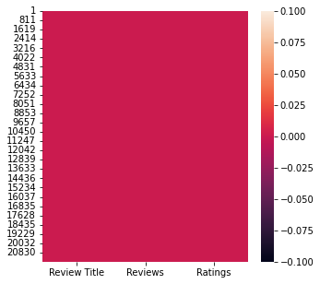
Checking for Missing Values
Dataset after removing missing values
Missing Data in Dataset using heatmap
Since the consolidated missing records were only around 1.03%, we dropped these records from the dataset as this will not have much impact on the model building.

Slide 10
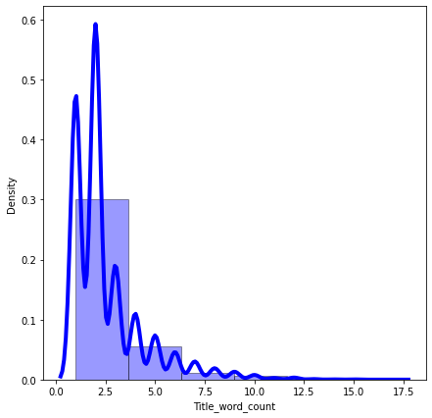
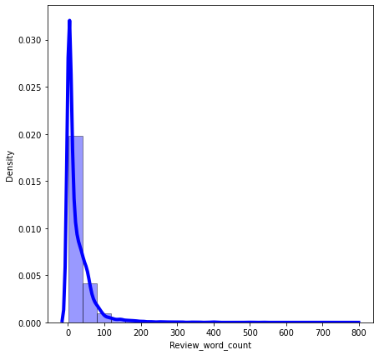
Data Visualization
Observations:
Most of the values in column 'Review Title' are having a word count between 2-7 words. But there are records which are having around 17 words in this column. So there can be presence of outliers in these records.
Most of the records are having 50-100 words in column 'Reviews', but there are some records which are having higher word counts than the average. So this can be considered as a presence of outliers in the data.

Slide 11
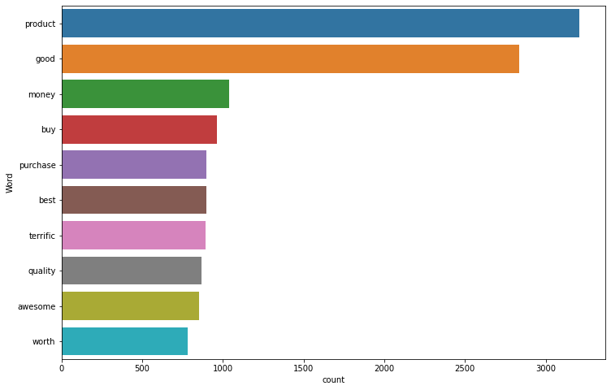
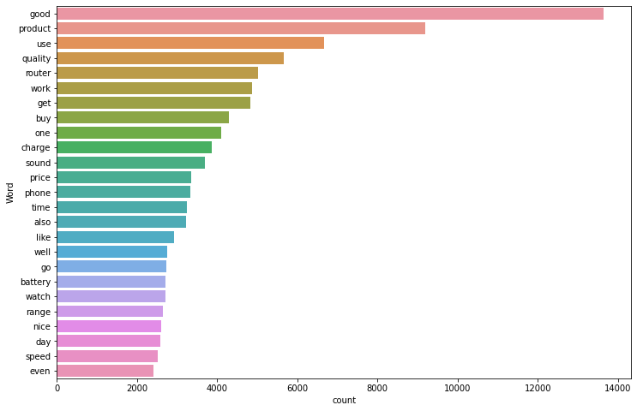
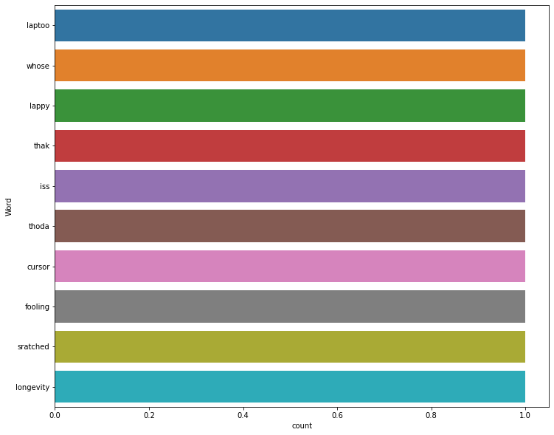
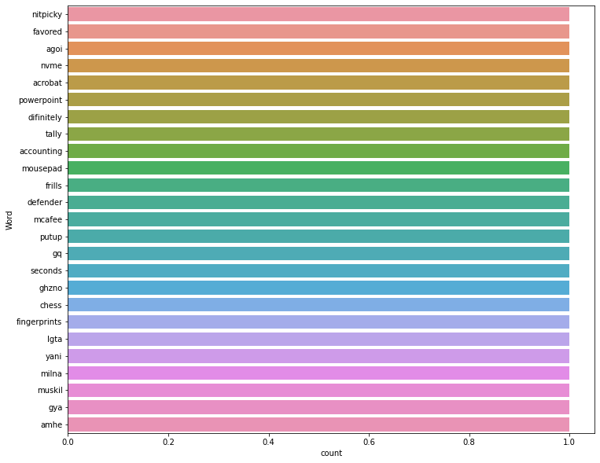
The words "product", "good" are the most frequent words used by the customers for rating the products as review title.
These are the least words used by customers for review.

Slide 12
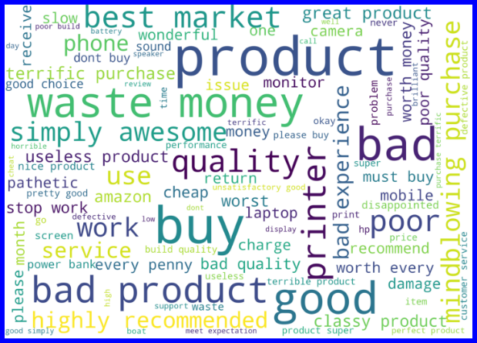
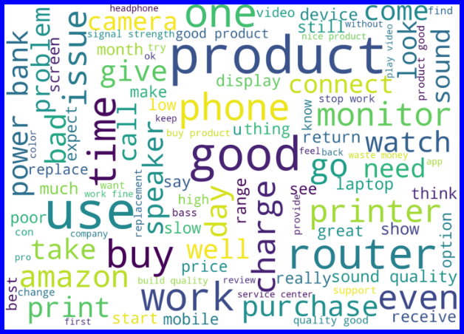
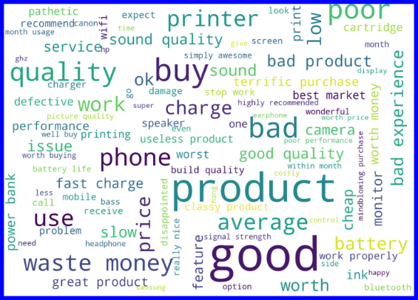
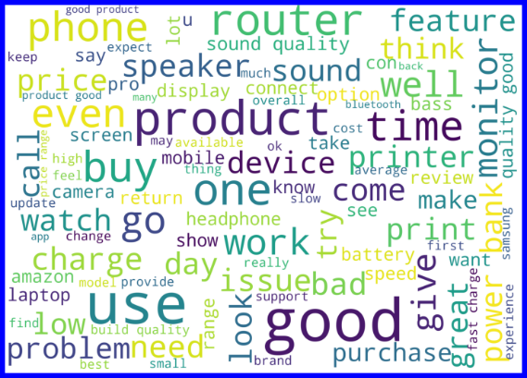
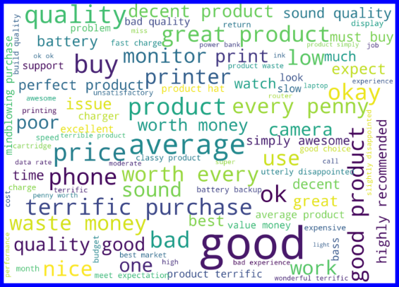
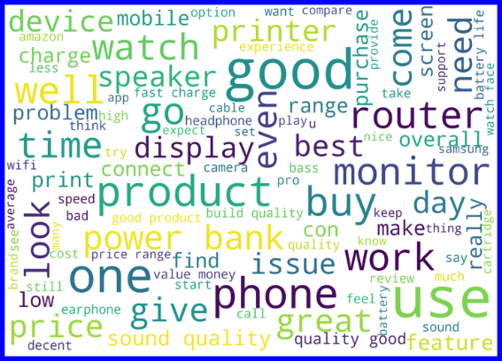
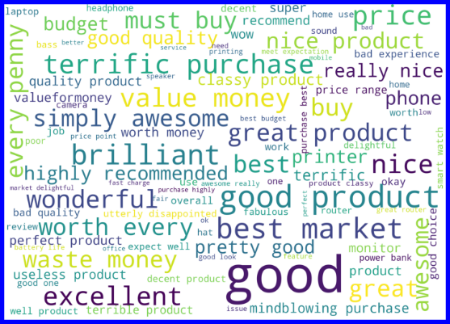
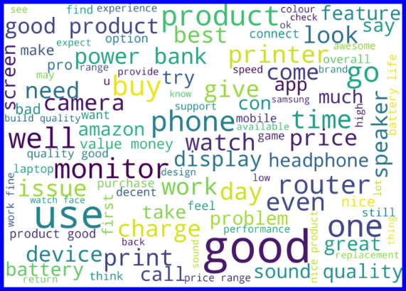
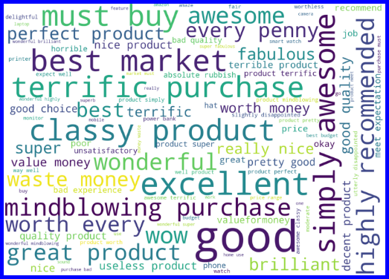
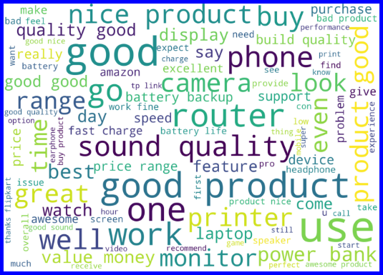
Word Cloud for reviews with rating 1
Word Cloud for reviews with rating 2
Word Cloud for reviews with rating 3
Word Cloud for reviews with rating 4
Observations:
With word cloud we were able to identify the frequent words which were used by customers for review of different ratings.
Most of the frequent words are related to the quality of the product irrespective of the rating.
Word Cloud for reviews with rating 5

Slide 13
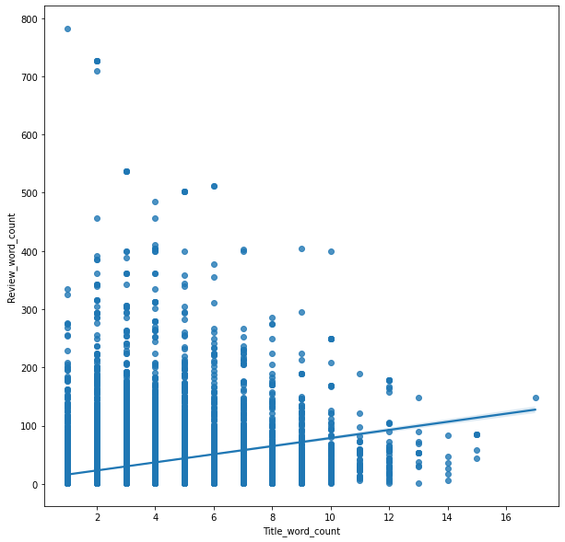
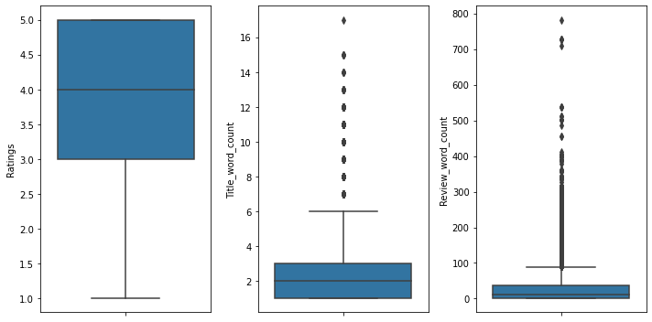
Data Cleansing
Removal of Outliers Outliers
We have used ZScore outlier removal method for removing the outliers data from the dataset. By outliers in this context, we mean the records with word counts which has huge difference from the average. After removing the outlier data from the dataset, we were losing only 3.53% of records from the dataset.
Distribution of word counts for each record in dataset

Slide 14
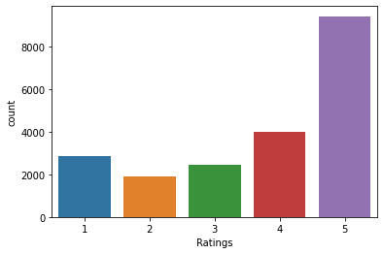

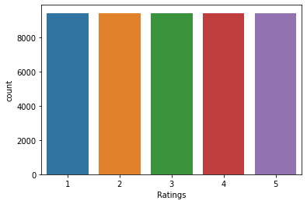

Model/s Development and Evaluation
Identification of possible problem-solving approaches (methods)
Vectorizing the Text Data in Dataset
We used tfidf vectorizer for vectorizing the text data in the dataset.
Balancing the dataset
We used smote technique to oversample the data in dataset to equalize the number of records in each categories.
Number of records for each category before balancing
Number of records for each category after balancing

Slide 15
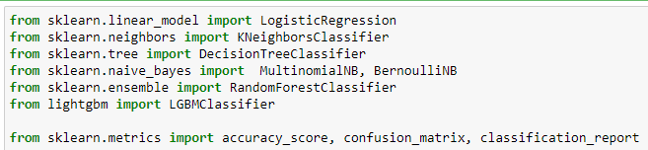
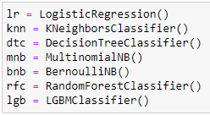
Importing required libraries for building the model
Creating the instances for the algorithms
mod_test: Training and testing the model
cross_val: Finding the best cross validation mean score for each model.

Slide 16
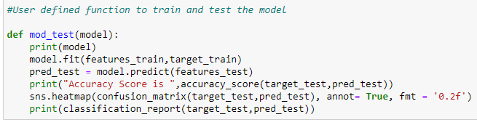
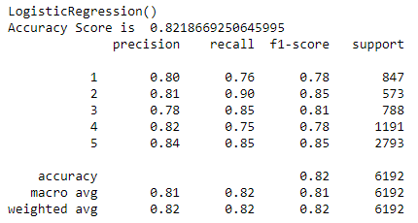
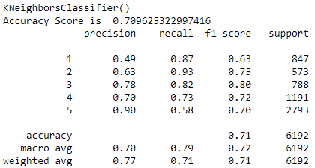
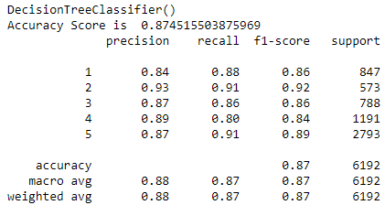
Testing of Identified Approaches (Algorithms) and evaluation of selected models
Code Snippet for function to test the model
Model Performance
Logistic Regression
KNeighborsClassifier
DecisionTreeClassifier
Testing the model performance
Testing the model performance
Testing the model performance

Slide 17
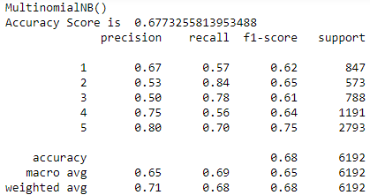
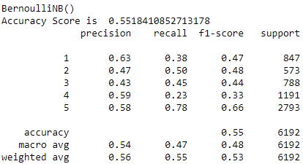
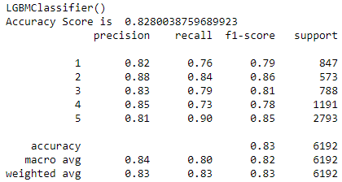
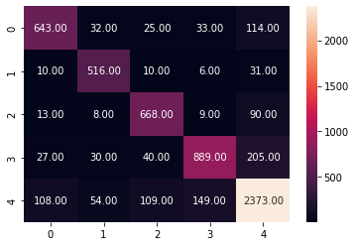
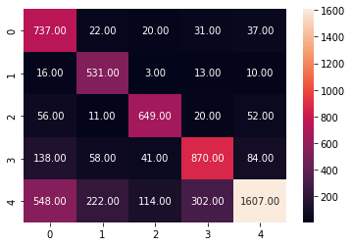
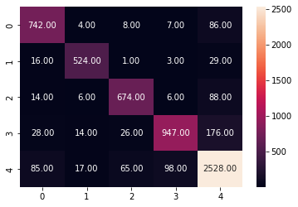
MultinomialNB
BernoulliNB
LGBMClassifier
Testing the model performance
Testing the model performance
Testing the model performance
Confusion Matrix
Logistic Regression
KNeighborsClassifier
DecisionTreeClassifier

Slide 18
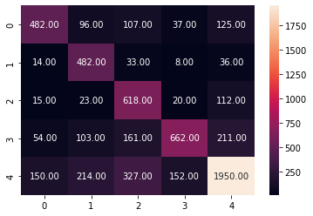
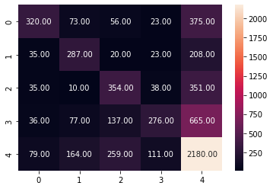
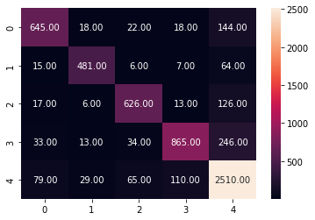
MultinomialNB
BernoulliNB
LGBMClassifier
After training and testing the models, the DecisionTree Classifier(dtc) and RandomForest Classifier (rfc) are performing well and providing the maximum accuracy score. Now let's check the cross-validation score to find the best performing model.

Slide 19
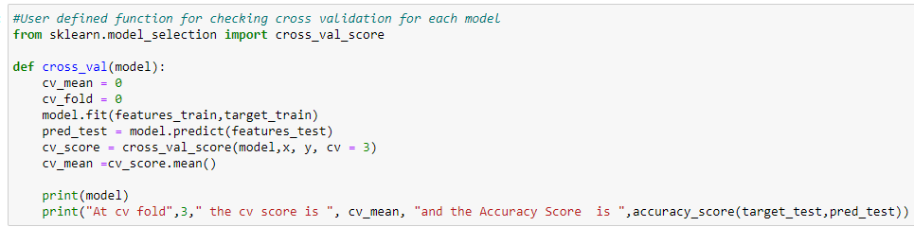
Cross Validation
Code Snippet for function to find the cross validation mean score
LogisticRegression
At cv fold 3 the cv score is 0.43572224645054997 and the Accuracy Score is 0.8218669250645995
KNeighbors Classifier
At cv fold 3 the cv score is 0.4229781460483597 and the Accuracy Score is 0.709625322997416
DecisionTree Classifier
At cv fold 3 the cv score is 0.45117991956195186 and the Accuracy Score is 0.874515503875969
MultinomialNB
At cv fold 3 the cv score is 0.45229442263894953 and the Accuracy Score is 0.6773255813953488
BernoulliNB
At cv fold 3 the cv score is 0.4032078305955323 and the Accuracy Score is 0.5518410852713178
LGBMClassifier
At cv fold 3 the cv score is 0.42985899113243203 and the Accuracy Score is 0.8280038759689923

Slide 20
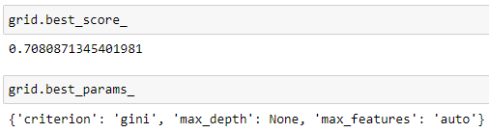
Hyperparameter Tuning
Best score and hyper parameters
The hyperparameter tuning didn't improve the score. So, we can stick to our existing model. The DecisionTree Classifier Model is performing well after all the testing, cross validations and tuning. So, we can consider this model as best performing model.

Slide 21
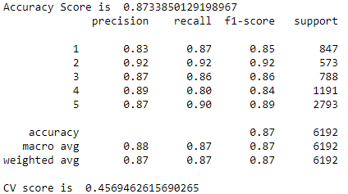


Finalized Model Performance with Tuned Parameters
Final Model Performance
Confusion Matrix
Saving the best model
We have saved the machine learning model for future predictions. We have serialized and saved the binary file as “ratings prediction model.pkl” using the pickle library.

Slide 22
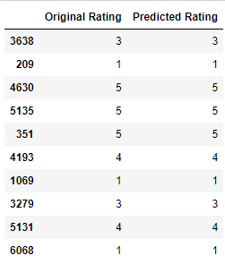
CONCLUSION
Now we have trained our model and it is ready to test with the actual data to cross verify the performance.
Our model is performing well with predictions and provided accurate results.
The DecisionTree Classifier (dtc) model is providing an accuracy score of 87.34% with a cross validation mean score of 45.7%.
Model Predictions and Actual Ratings

Slide 23
Key Findings and Conclusions of the Study
With the help of data science and machine learning, we were able to create a machine learning model using DecisionTree algorithm, which can predict the review ratings based on customer reviews.
Now this model can be used by the client to predict the ratings of customer’s review.
Learning Outcomes of the Study in respect of Data Science
As the E-commerce market is booming, customers are giving with various choices for purchasing the same product from different e-commerce websites. Review ratings helps the customers to easily analyse whether a product is worth buying without inspecting the customer reviews. Using the customer review rating, a customer can identify whether it is good to go for buying a product or not in a glance.
With the help of natural language processing (NLP) we were able to create a machine learning model which can predict the review rating based on customer reviews. With the help of advanced technologies, we will be able to recalibrate this model to suit with the changing trends and extreme text processing, machine will be able to analyse and identify the patterns and could help us to build much more powerful model which can accurately predict the customer ratings based on the customer reviews.

Slide 24
Limitations of this work and Scope for Future Work
Limitations
We tried to include as many records as possible in the dataset, but since the market we were studying was vast, we couldn’t include all the categories and had to let down many other products and their valuable comments for building this model.
In this study we were primarily concentrated on customer reviews, thus we didn’t include many other saliant features which could have been impacted the customer ratings such as product information, user experience on placing the order, order fulfilment, after sale services etc.
We only included the data from major e-commerce websites in India, but there are many other e-commerce websites which could have been included in the study.
Scope
In future, to build a powerful machine learning model, we can include much larger dataset by including many other features about the customer reviews and product information. This will help the machine to learn much more complex patterns and avoid the chances of underfitting.
As a future goal, it is better to include many more product categories and collect data from many other e-commerce websites which will help us to collect powerful dataset which can be used for building a powerful predictive model.
In future as the technologies are advancing, we can use many advanced features which can process the text in a way that machine can learn the complex text patters without losing out data from the dataset.

Slide 25
Thank You

